Slide 1
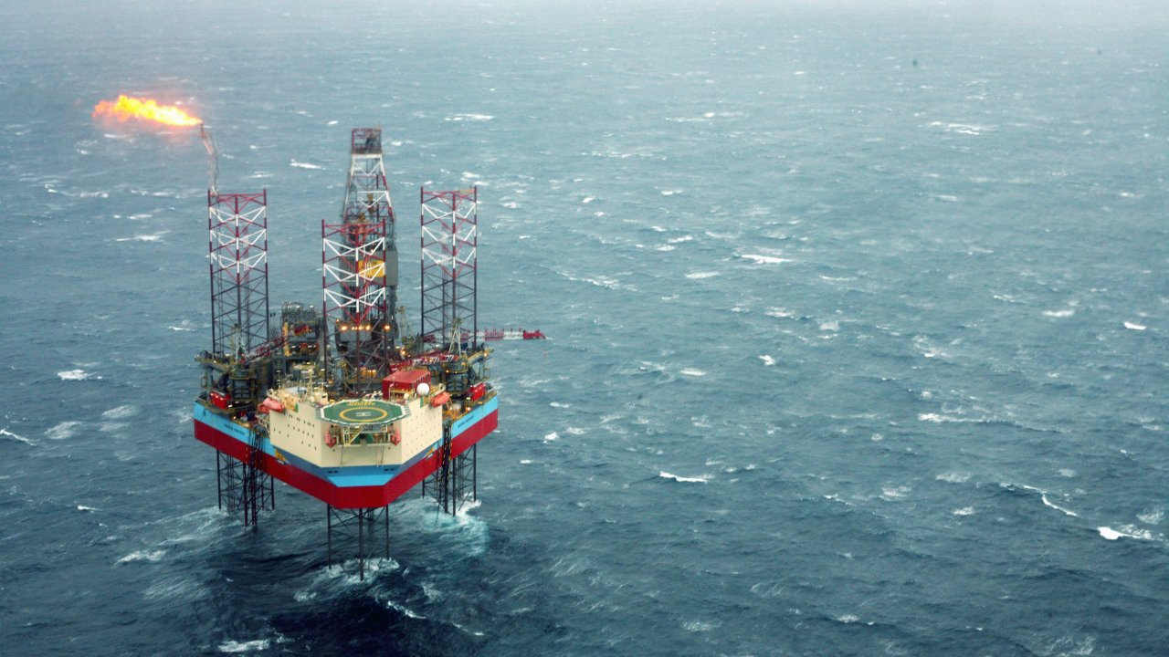
Time Series Forecasting of Oil Well Production Using Machine Learning

Slide 2
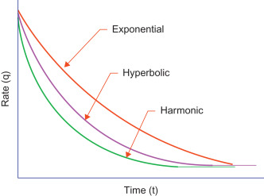
Introduction
Predicting the future Production of an Oil Well is one of the key tasks of a reservoir engineer which is tied to the profitability of the well. The ability to predict the future production rates of an oil well gives the stakeholder the ability to decide early in the production life of the well whether the well is profitable to keep or is more profitable to sell. The industry standard in predicting the production of an oil or a gas well is Decline Curve Analysis. This analysis is based on fitting different types of curve to the production rate. Machine learning unlike decline curve analysis gives as the option to try multiple types of algorithms from classical to deep learning algorithm and from univariate to multivariate analysis.

Slide 3
Problem Definition
How do we forecast the future oil production of an oil well given the production history and other variables such choke size, downhole pressure, etc. ?

Slide 4

Data Wrangling
The volve field oil production data is from the 40,000 data files that Norwegian oil and gas company Equinor released as part of the Open licensed Volve Data Set. The oil production data is in an excel sheet that consist of the production history and other variables for seven wells.

Slide 5
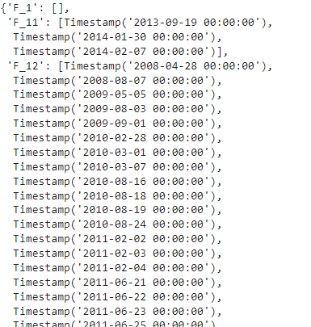
Data Wrangling
One of the most important task in the data preparation process is to ensure that there are no missing timestamps. Some wells have timestamps that were missing and were subsequently added.

Slide 6
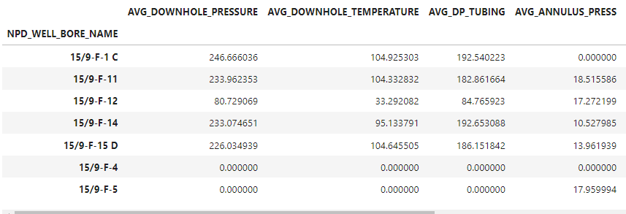
Data Wrangling
We then replaced the missing values with average values of each variable except for the missing values of the variables that pertain to volume which were replaced with zeroes.

Slide 7
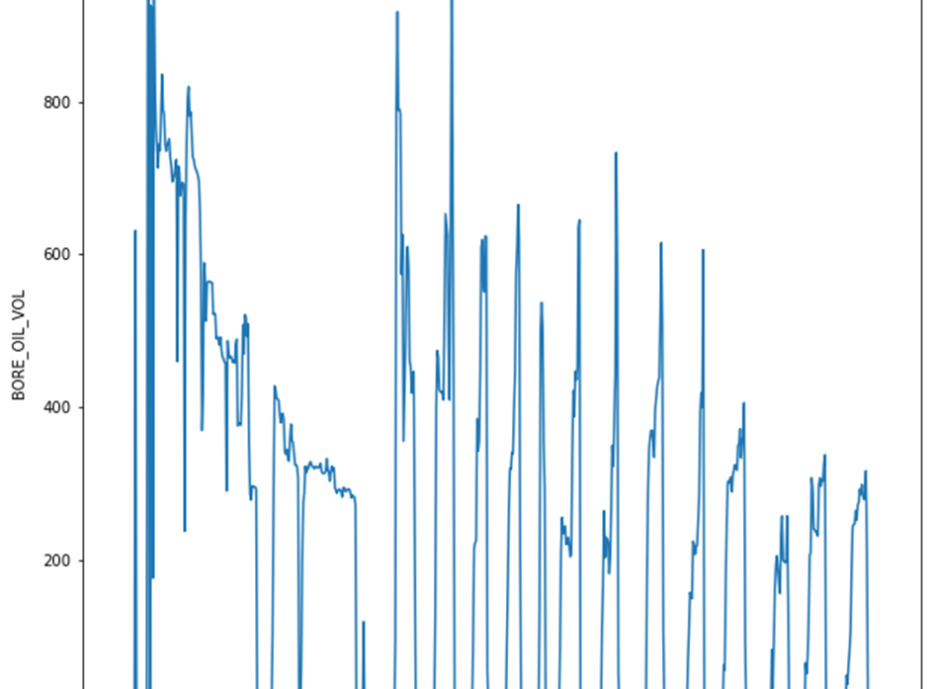
Exploratory Data Analysis
The F_1 Well initially followed a typical decline curve and then followed a sporadic shut-in periods.

Slide 8
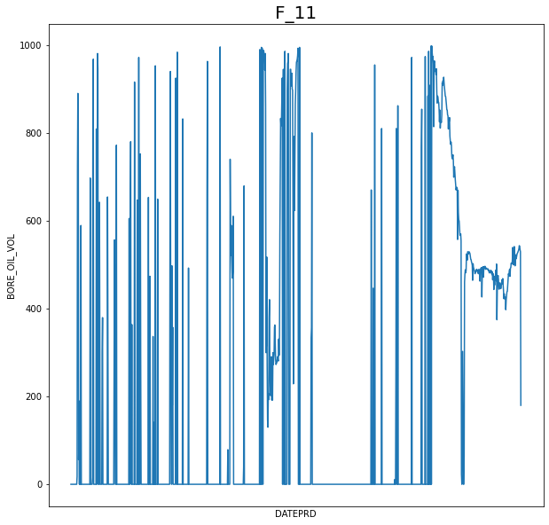
Exploratory Data Analysis
The F_11 Well does not follow a typical decline curve.

Slide 9
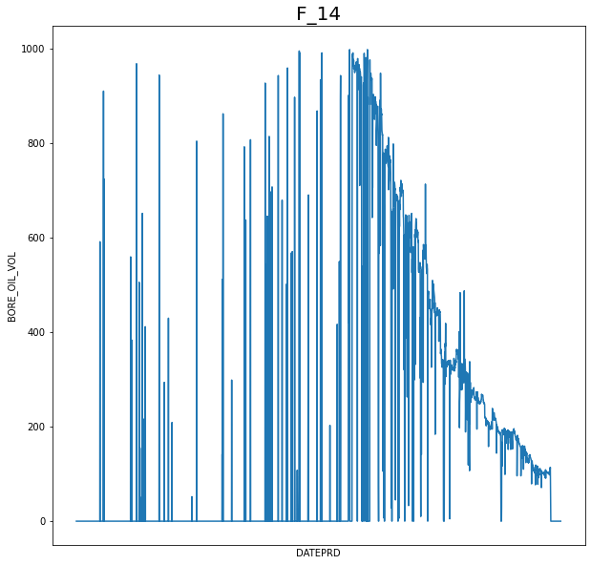
Exploratory Data Analysis
The F_14 Well followed a typical decline curve during the second half of the oil production.

Slide 10
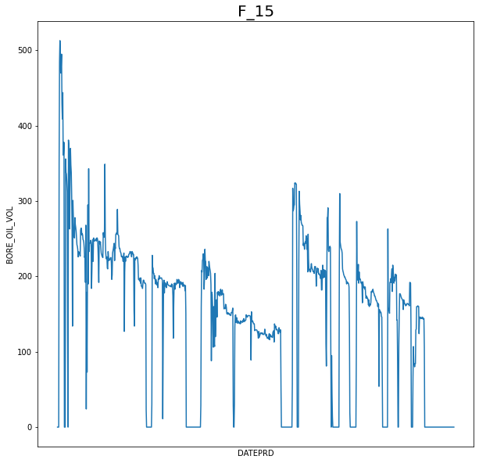
Exploratory Data Analysis
The F_15 Well did not follow a typical decline curve.

Slide 11
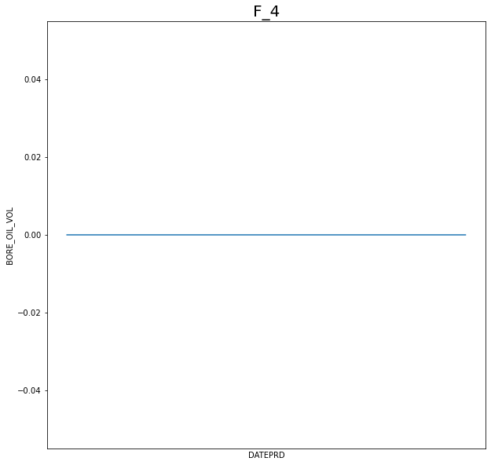
Exploratory Data Analysis
The F_4 well did not produce any oil at all but instead was used as a water injection well.

Slide 12
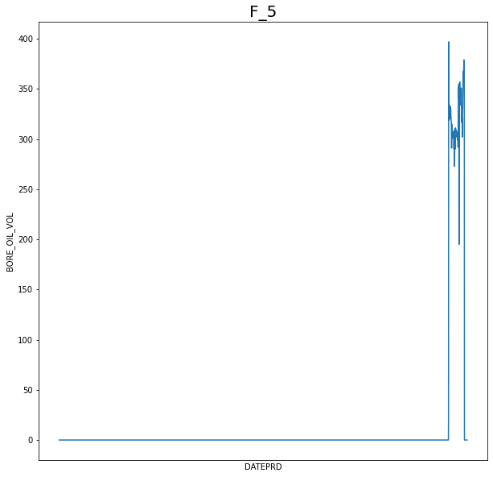
Exploratory Data Analysis
The F_5 well did not follow a typical decline curve and only produced oil for a short period of time.

Slide 13
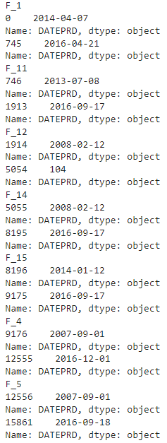
Exploratory Data Analysis
Each well came online at different periods

Slide 14
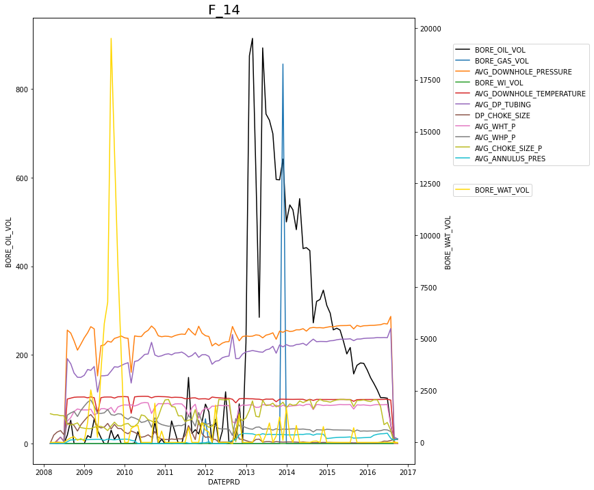
Exploratory Data Analysis
Since the production data is erratic for the daily rate, the data for each well was first down sampled to weekly and then later was down sampled to monthly to make it easier for the algorithms to forecast oil production rates.

Slide 15
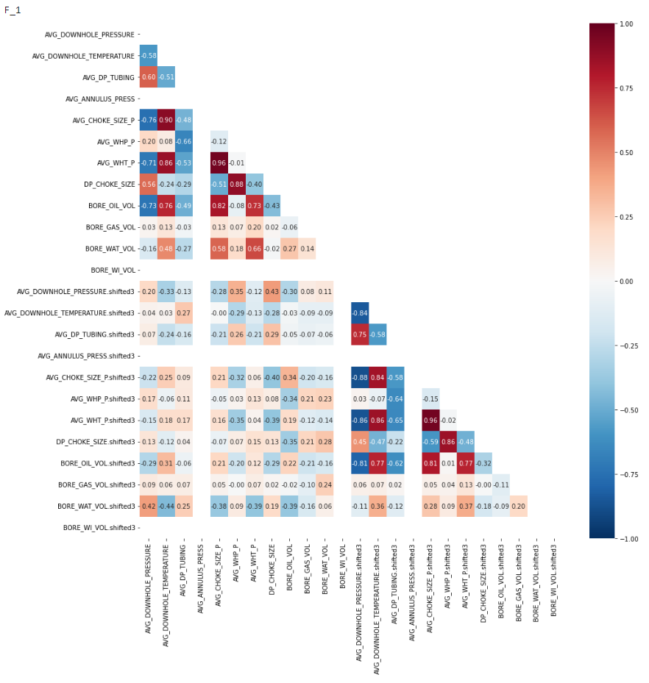
Exploratory Data Analysis
For some wells there is a stronger correlation between target variable and the lag variable. Another important observation is that the direction is not the same for every variable across each well. For example, there is a positive correlation between downhole pressure for some wells and negative for the rest of the wells.

Slide 16
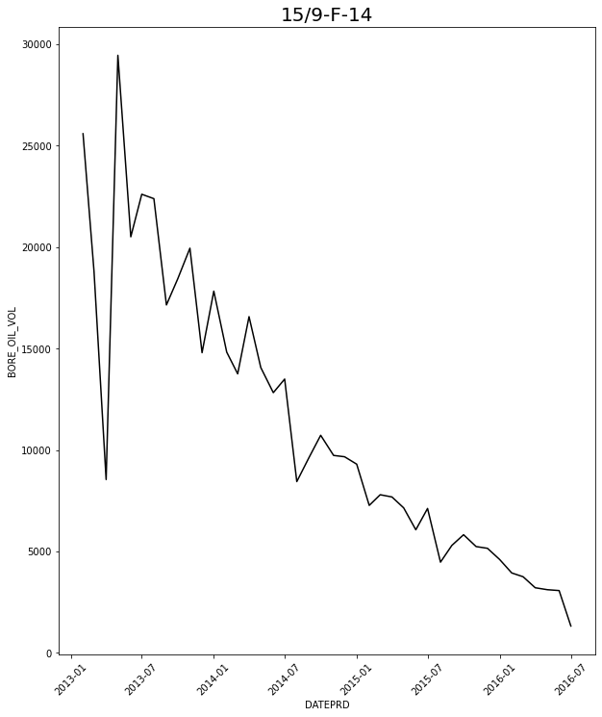
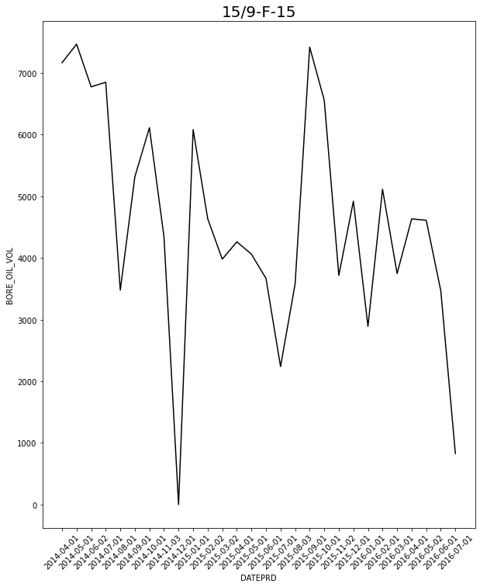
Modelling
We begin our modelling by selecting two wells representing a typical decline curve and one that does not follow a typical decline curve. Discarding the time period that has an erratic production history the F_14 well follows a typical decline curve. The F_15 well on the other hand does not follow a typical decline curve. We will then use both wells in our modelling.

Slide 17
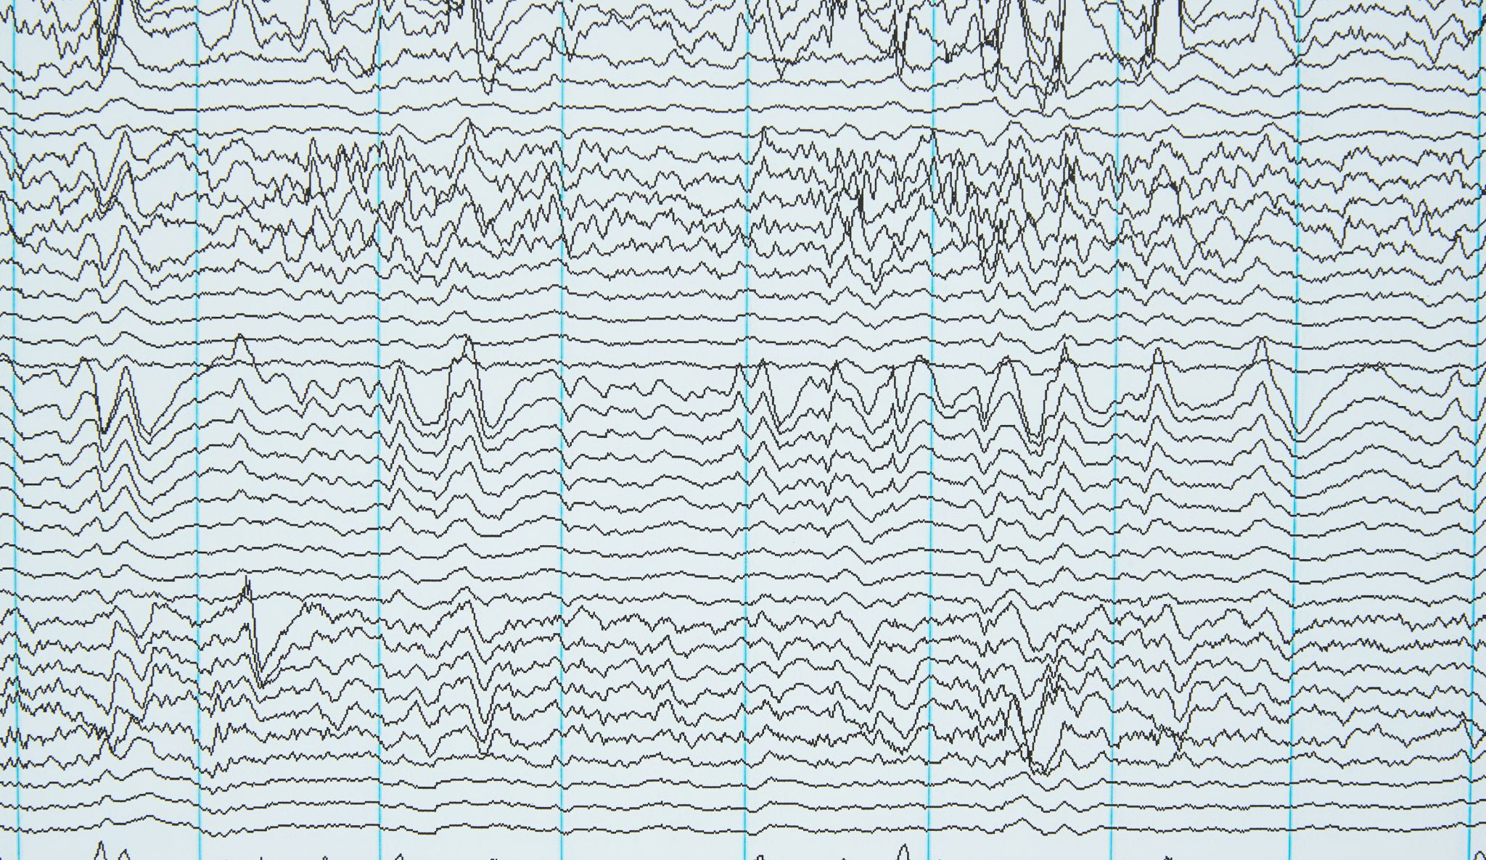
Classical Time Series Forecasting
We trained the two wells first with classical time series algorithms. These were the following models, Autoregressive Models, Moving Average Models, Autoregressive Integrated Moving average Models and Autoregressive Integrated Moving Average with Exogeneous Variables Models. The last 4 months for both wells will serve as the test set and the Mean Absolute Percentage Error (MAPE) will serve as our metric.

Slide 18
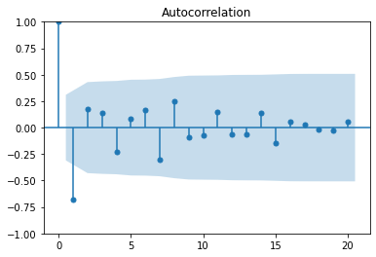
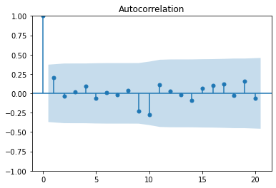
Classical Time Series Forecasting: Autoregressive Model
An Autoregression model is a time series model that uses observations from previous time steps as input to a regression equation to predict the value at the next time step. In order to build our AR models, we differenced the time series for both wells to the nth degree until the model is stationary. The figure to the left is the F-14 well which requires second order differencing and the F-15 well which does not require differencing.

Slide 19
Classical Time Series Forecasting: Autoregressive Model
Knowing the differencing required to make our time series stationary we then used for loops with different P values and select the best models based on the values of the Bayesian Information Criterion an Akaike Information Criterion.

Slide 20
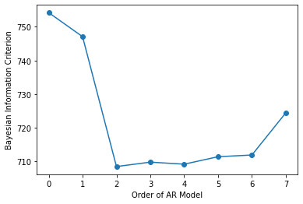
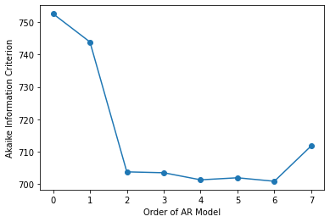
Classical Time Series Forecasting: Autoregressive Model
For F-14 time series the best models are the models with P = 2 and P = 6 and d = 2. The model with P = 2 has the lowest BIC and the model with P = 6 has the lowest AIC.

Slide 21
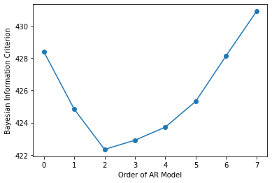
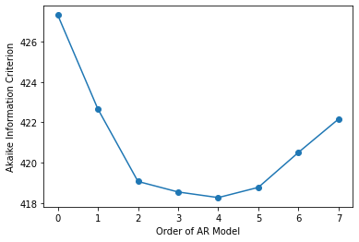
Classical Time Series Forecasting: Autoregressive Model
For F-15 time series the best models are the models with P = 2 and P = 4 while d = 0. The model with P = 2 has the lowest BIC and the model with P = 4 has the lowest AIC.

Slide 22
Classical Time Series Forecasting: Moving Average Model
A Moving Average model is a model that estimate the trend-cycle at time t obtained by averaging values of the time series within k periods of t. Just like the AR model in order to build our moving average models we must make our time series stationary first. After taking their respective differencing we then used for loops with different d values and select the best models based on the values of the Bayesian Information Criterion an Akaike Information Criterion.

Slide 23
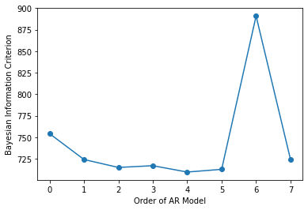
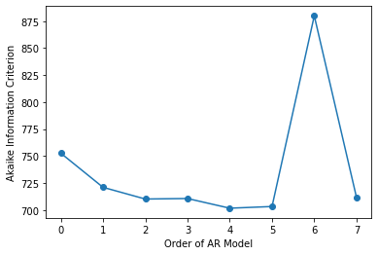
Classical Time Series Forecasting: Moving Average Model
For F-14 time series the best model is the model with d = 2 and q = 4 based on BIC and AIC scores.

Slide 24
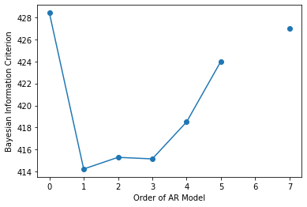
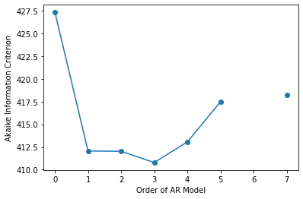
Classical Time Series Forecasting: Moving Average Model
For F-15 time series the best models are the models with d = 0 and q = 1 and q = 3 based on BIC and AIC scores.

Slide 25
Classical Time Series Forecasting: ARIMA Model
An ARIMA model is combination of AR and MA model with differencing. Just like the AR and MA model in order to build our moving average models we must make our time series stationary first. After taking their respective differencing we then used for loops with different P and d values and select the best models based on the values of the Bayesian Information Criterion an Akaike Information Criterion.

Slide 26
Classical Time Series Forecasting: ARIMA Model
For the F – 14 time series the ARIMA model with p = 6, d = 2, q = 0 has the lowest AIC score. For the F – 15 time series the ARIMA model with p = 0, d = 0 and q = 2 has the lowest AIC and BIC score.

Slide 27
Classical Time Series Forecasting: ARIMAX Model
An ARIMAX model is combination of AR and MA model with differencing plus exogenous variables. Just like the AR and MA model in order to build our moving average models we must make our time series stationary first. After taking their respective differencing we then used for loops with different P and d values and select the best models based on the values of the Bayesian Information Criterion an Akaike Information Criterion. We used the following variables as our exogenous variables :
'AVG_DOWNHOLE_PRESSURE’,
'AVG_DP_TUBING’
'AVG_ANNULUS_PRESS’
'AVG_WHT_P','BORE_GAS_VOL’
'DP_CHOKE_SIZE’
'AVG_CHOKE_SIZE_P’
'AVG_DOWNHOLE_TEMPERATURE’
'AVG_WHP_P','BORE_WAT_VOL'

Slide 28
Classical Time Series Forecasting: ARIMAX Model
For the F – 14 well the best model is the model with p = 1, d = 2 and q = 0. On the other hand, for the F – 15 model the best model is the model with P = 0 and q = 2.

Slide 29
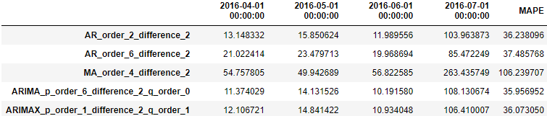
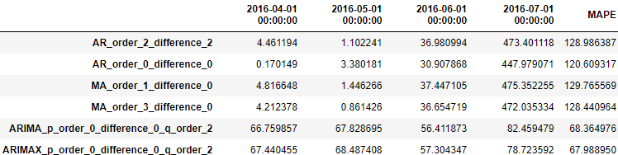
Performance of Models
F - 14
F - 15
The best models for both wells are the ARIMAX models and as expected the simple models performed significantly worse than the ARIMAX models. Also as expected the F-14 well which followed a typical decline curve was easier to model than the F-15 model which did not follow a typical decline curve(35% MAPE vs 65% MAPE for the ARIMAX Models).

Slide 30

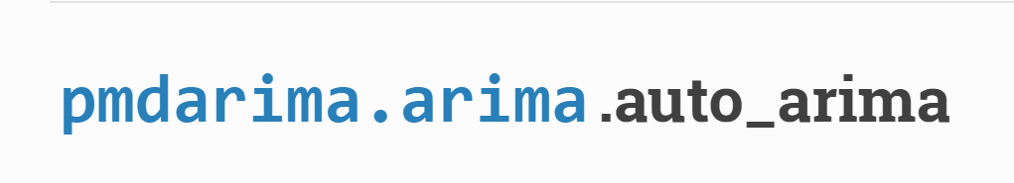


Advanced Modelling - Specialized Packages

Slide 31
Advanced Modelling - KATS
Kats (Kit for Analyzing Time Series) is a toolkit to analyze time series data, a lightweight, easy-to-use, and generalizable framework to perform time series analysis. It is being developed by facebook to serve as a one stop shop for time series analysis, including detection, forecasting, feature extraction/embedding, and multivariate analysis. There are a total of 10 forecasting models in KATS in this project we will use the following models: ARIMA, fbProhpet, Theta, Harmonic Regression, LSTM, and Ensemble Model.

Slide 32
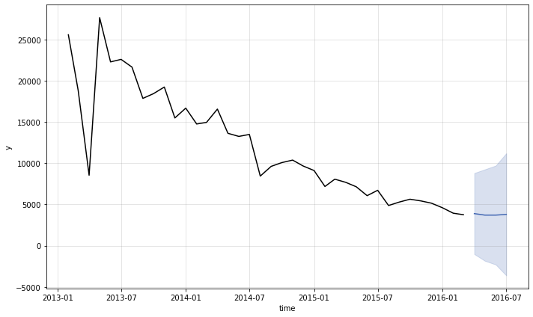
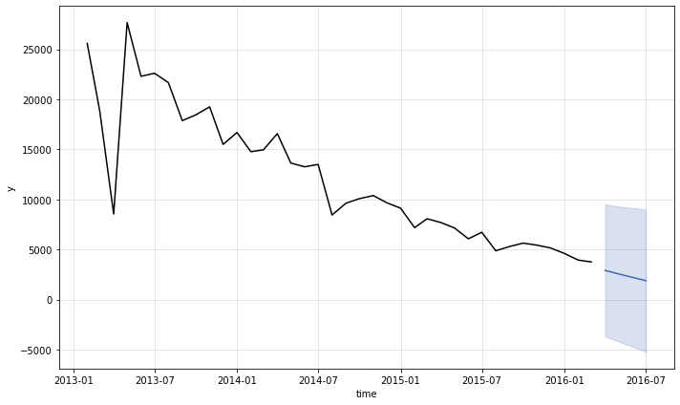
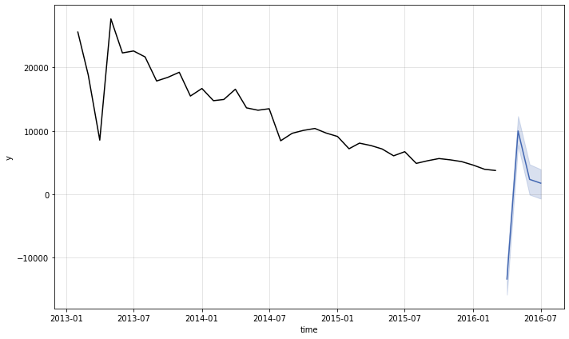
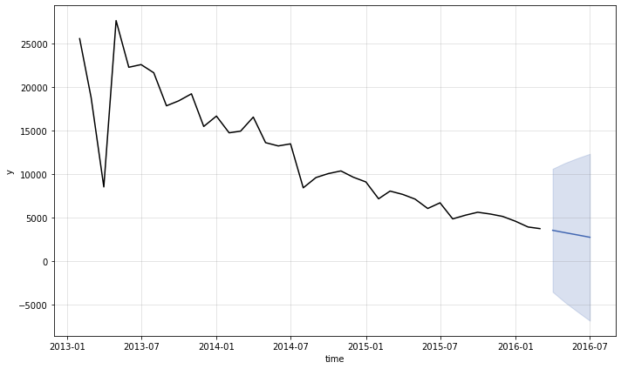
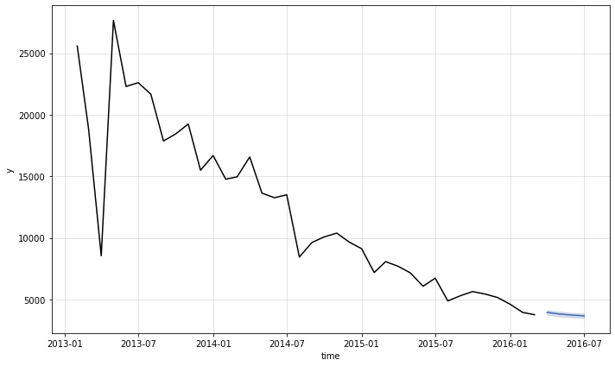
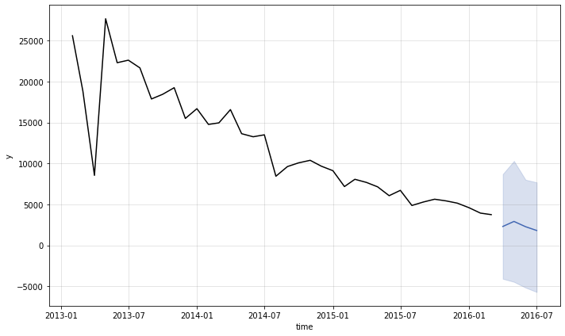
Advanced Modelling – KATS – F - 14
ARIMA
Harmonic Regression
fbProphet
Theta
LSTM
Ensemble

Slide 33
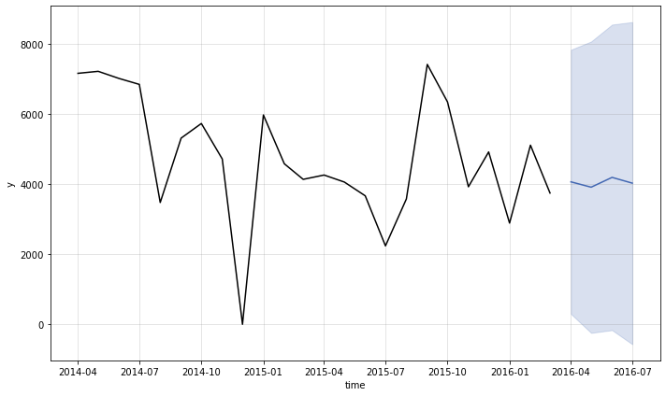
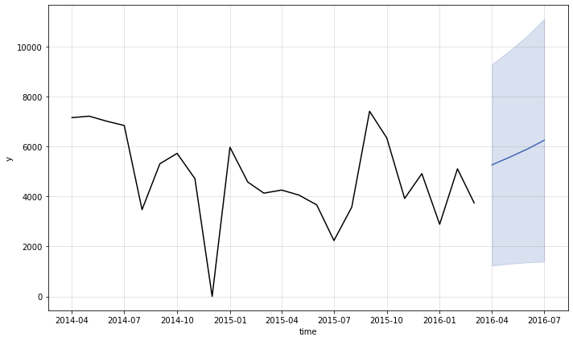
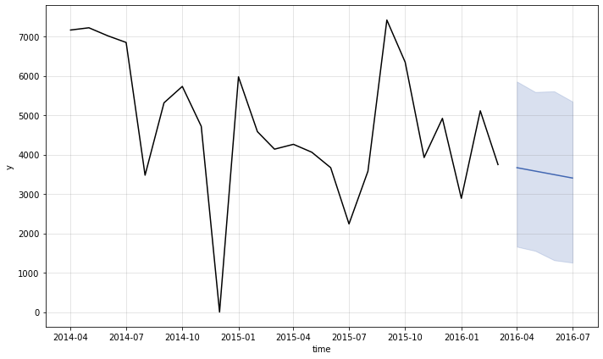
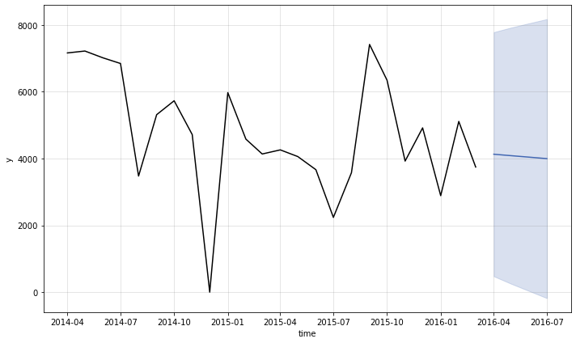
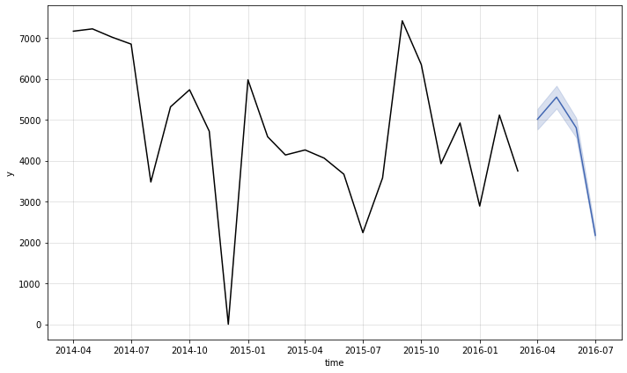
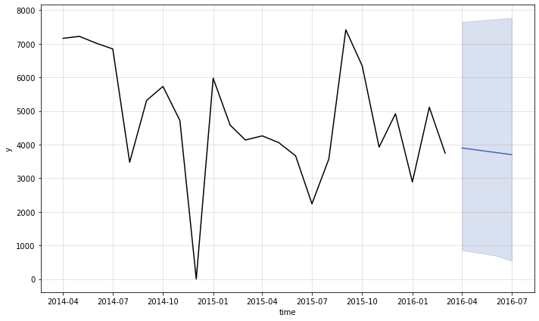
Advanced Modelling – KATS – F - 15
ARIMA
Harmonic Regression
fbProphet
Theta
LSTM
Ensemble

Slide 34
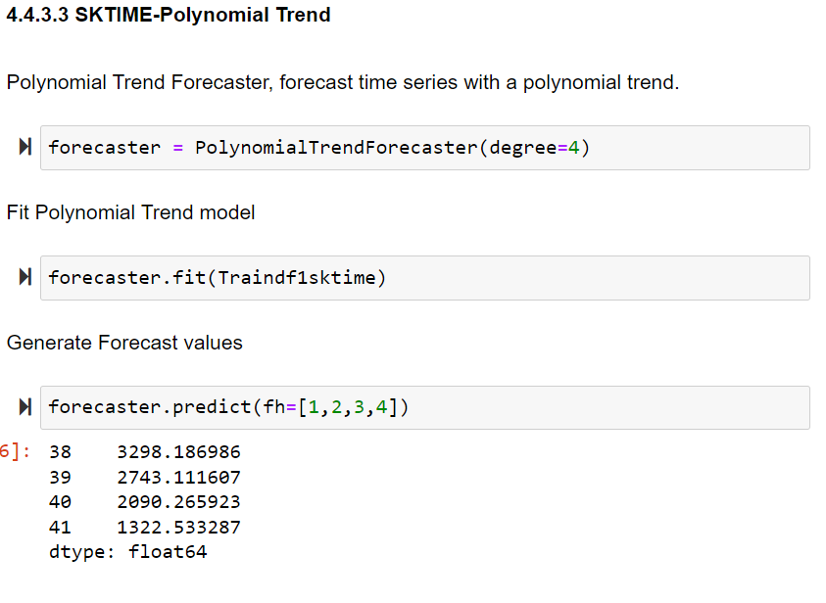
Advanced Modelling - SKTIME
SKTIME offers scikit-learn compatible interfaces and model composition tools. It is an open-source Python toolbox for machine learning with time series. SKtime extends the scikit-learn API to time series tasks. We built models using the Theta, TBATS an Polynomial trend algorithms.

Slide 35
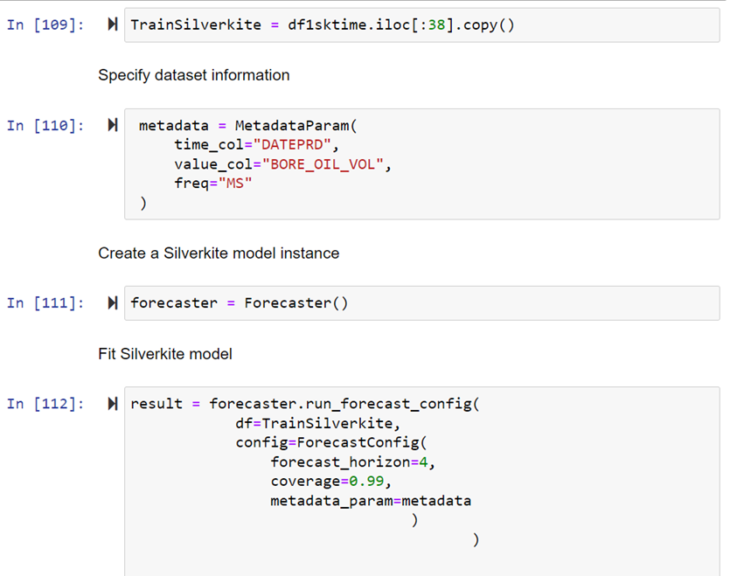
Advanced Modelling - Silverkite
The Silverkite algorithm is part of the Greykite package. Silverkite, is highly customizable, with tuning parameters to capture diverse time series characterics. The output is interpretable, allowing visualizations of the trend, seasonality, and other effects, along with their statistical significance.

Slide 36
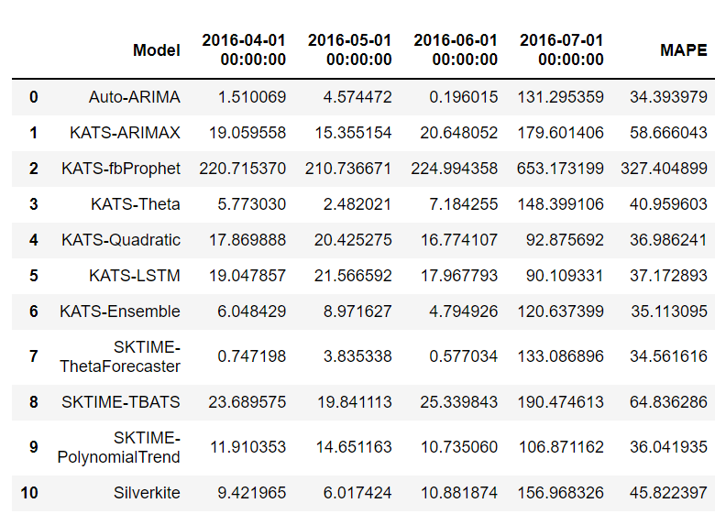
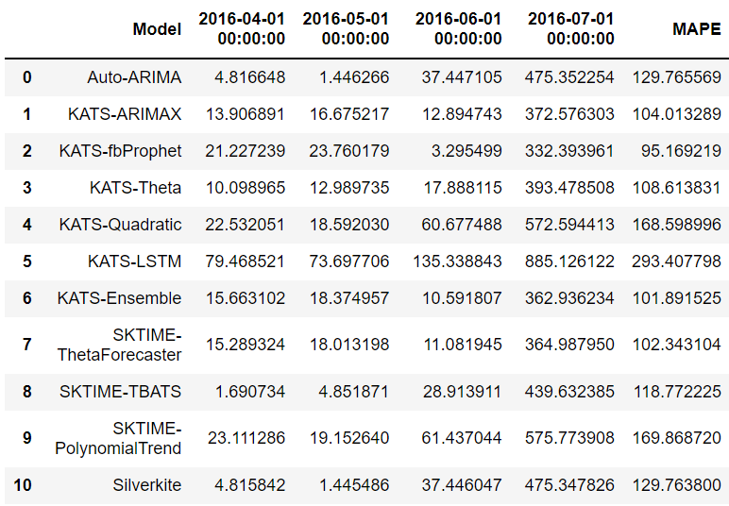
Performance of Models
F – 14 Well
F – 15 Well
The best model for the F-14 well is the Auto-ARIMA Model on the other hand the best model for the F - 15 well is the KATS-fbProphet model. Due to the sudden drop of the oil production for the last month this significantly increases the MAPE for all models.

Slide 37

Advanced Modelling - Deep Learning
In the final modelling notebook, we utilized deep learning algorithms using TensorFlow with Keras with the following architectures.
Multi-level perceptron
LSTM (Long Short-Term Memory)
Convolutional Neural Network.

Slide 38
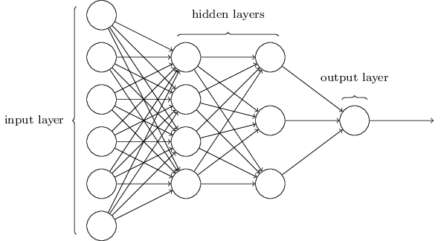
Multi – Level Perceptron
A multilayer perceptron (MLP) is a fully connected class of feedforward artificial neural network (ANN). The term MLP is used ambiguously, sometimes loosely to mean any feedforward ANN, sometimes strictly to refer to networks composed of multiple layers of perceptrons(with threshold activation. Multilayer perceptron's are sometimes colloquially referred to as "vanilla" neural networks, especially when they have a single hidden layer. The MLPs can be used for time series forecasting by taking multiple observations at prior time steps, called lag observations, and using them as input features and predicting one or more time-steps from those observations. In this notebook we created MLP models with the following characteristics.
3 layers
Rectified Linear Units as the activation function for all layers.
Mean squared error as the loss function
Adam optimization algorithm as the optimizer

Slide 39
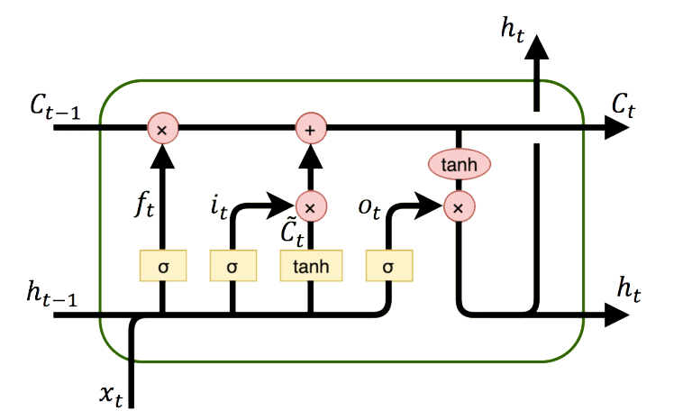
Long short-term memory (LSTM)
Long short-term memory or LSTM is an artificial recurrent neural network (RNN) architecture that unlike standard feedforward neural networks has feedback connection/s. LSTMS are well-suited to classifying, processing, and making predictions based on time series data. The LSTM has an internal memory allowing it to accumulate internal state as it reads across the steps of given input sequence. In this notebook we created LSTM models with the following characteristics. In this notebook we created LSTM models with the following characteristics.
3 layers
Rectified Linear Units as the activation function for all layers.
Mean squared error as the loss function
Adam optimization algorithm as the optimizer

Slide 40
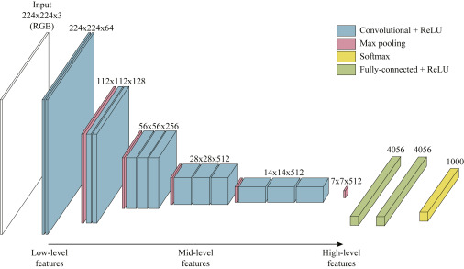
Convolutional Neural Network (CNN)
CNNs or Convolutional Neural Network models are is a class of artificial neural network ANN, most commonly applied to analyze visual imagery. CNNs are also known as Shift invariant or space Invariant Artificial Neural Networks (SIANN) based on the shared-weight architecture of the convolution kernels or filters that slide along input features and provide translation-equivalent responses known as feature maps. In this notebook we created CNN models with the following characteristics. In this notebook we created LSTM models with the following characteristics.
5 layers
Rectified Linear Units as the activation function for all layers.
Mean squared error as the loss function
Adam optimization algorithm as the optimizer

Slide 41


Performance of Models
F - 14
F - 15
The best models for both wells are the ARIMAX models and as expected the simple models performed significantly worse than the ARIMAX models. Also as expected the F-14 well which followed a typical decline curve was easier to model than the F-15 model which did not follow a typical decline curve(35% MAPE vs 65% MAPE for the ARIMAX Models).

Slide 42
Summary
Our project shows that when it comes to time series forecasting, classical time series forecasting models can match and outperform the advanced models and deep learning models. As can be seen from our models it is the last month for both wells that is significantly throwing off our MAPE scores. Forecasting oil production is just one of the many problems that machine learning can be applied in solving petroleum engineering problems. This concludes our modelling.

